Slide 1

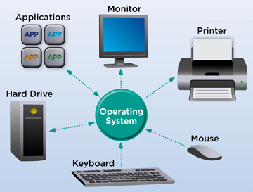
Azərbaycan Dövlət Neft və Sənaye Universiteti
Computer Architecture and Operating Systems

Slide 2
A computer system consists of hardware and systems software that work together to run application programs.
Specific implementations of systems change over time, but the underlying concepts do not.
All computer systems have similar hardware and software components that perform similar functions.
This course is aimed at programmers who want to get better at their craft by understanding how these components work and how they affect the correctness and performance of their programs.
Introduction to Computers

Slide 3
Think about some of the different ways that people use computers.
In school, students use computers for tasks such as
writing papers
searching for articles
sending email
participating in online classes
playing games with classmates
etc.
Introduction to Computers

Slide 4
At work, people use computers to
analyze data
make presentations
conduct business transactions
communicate with customers and coworkers
control machines in manufacturing facilities
and do many other things.
At home, people use computers for tasks such as
paying bills
shopping online
communicating with friends and family
playing computer games
etc.
Introduction to Computers

Slide 5
And don’t forget that
cell phones
iPods
smart phones
car navigation systems
and many other devices are computers too.
The uses of computers are almost limitless in our everyday lives.
Computers can do such a wide variety of things because they can be “programmed”.
This means that computers are not designed to do just one job, but to do any job that their programs tell them to do.
Introduction to Computers

Slide 6
A program is a set of instructions that a computer follows to perform a task.
Programs are commonly referred to as software.
Software is essential to a computer because it controls everything the computer does.
All of the software that we use to make our computers useful is created by individuals working as programmers or software developers.
Introduction to Computers

Slide 7
A programmer, or software developer, is a person with the training and skills necessary to design, create, and test computer programs.
Today, you will find programmers’ work used in
business
medicine
government
law enforcement
agriculture
academics
entertainment
and many other fields.
Introduction to Computers

Slide 8
Before we begin exploring the concepts of programming, you need to understand a few basic things about computers and how they work.
First, we will discuss the physical components that computers are commonly made of.
Next, we will look at how computers store data and execute programs.
Finally, we will get a quick introduction to the myriad of programming languages that you can use to write programs.
Introduction to Computers

Slide 9
Concept:
The physical devices that a computer is made of are referred to as the computer’s hardware.
The programs that run on a computer are referred to as software.
The term hardware refers to all of the physical devices, or components, that a computer is made of.
A computer is not one single device, but a system of devices that all work together.
Like the different instruments in a symphony orchestra, each device in a computer plays its own part.
Hardware

Slide 10
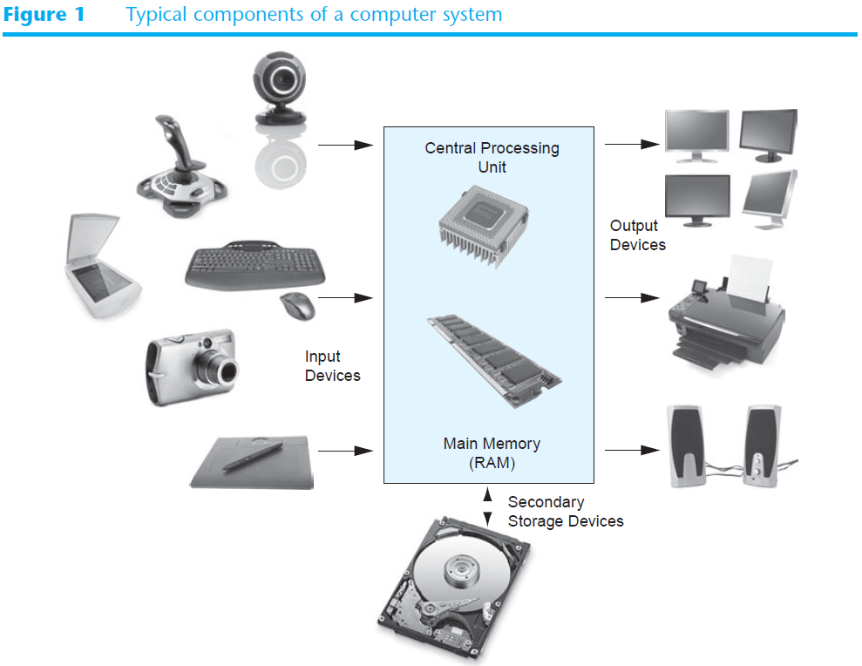

Slide 11
As shown in Figure 1, a typical computer system consists of the following major components:
• The central processing unit (CPU)
• Main memory
• Secondary storage devices
• Input devices
• Output devices
Let’s take a closer look at each of these components.
Hardware

Slide 12
When a computer is performing the tasks that a program tells it to do, we say that the computer is running or executing the program.
The central processing unit, or CPU, is the part of a computer that actually runs programs.
The CPU is the most important component in a computer because without it, the computer could not run software.
In the earliest computers, CPUs were huge devices made of electrical and mechanical components such as vacuum tubes and switches.
Hardware: CPU

Slide 13
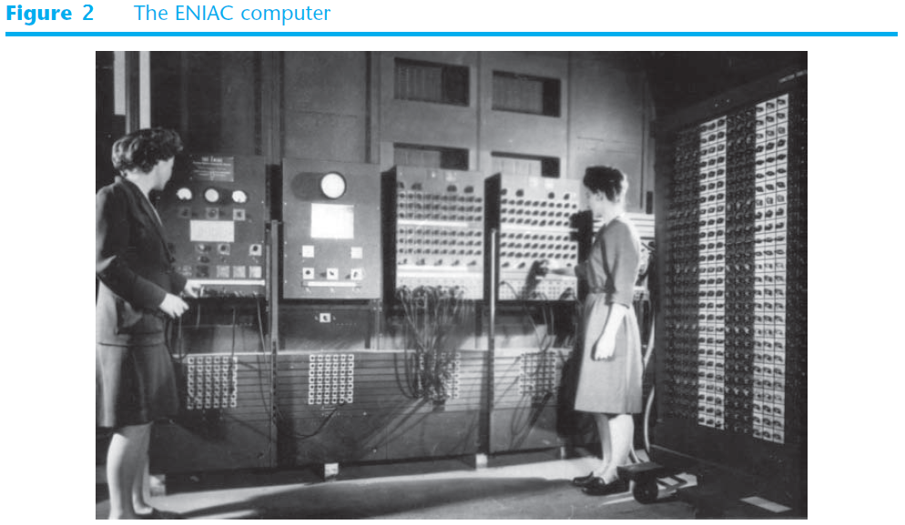
Figure 2 shows the historic ENIAC computer.
Hardware: CPU

Slide 14
The ENIAC, which is considered by many to be the world’s first programmable electronic computer, was built in 1945 to calculate artillery ballistic tables for the U.S. Army.
This machine, which was primarily one big CPU, was 8 feet tall, 100 feet long, and weighed 30 tons.
Today, CPUs are small chips known as microprocessors.
In addition to being much smaller than the old electromechanical CPUs in early computers, microprocessors are also much more powerful.
Hardware: CPU

Slide 15
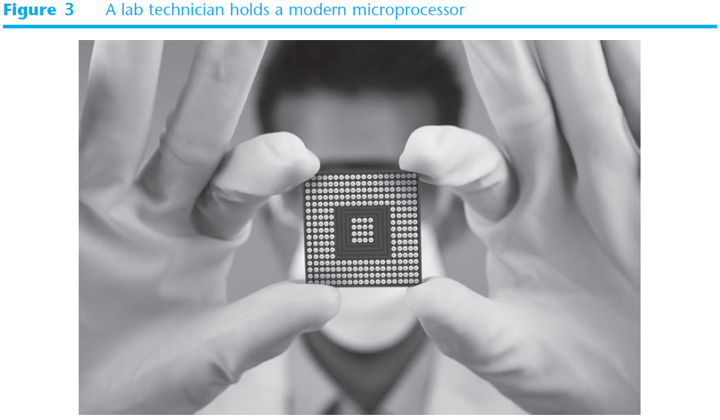
Figure 3 shows a photo of a typical microprocessor.
Hardware: CPU

Slide 16
You can think of main memory as the computer’s work area.
This is where the computer stores
a program while the program is running
the data that the program is working with
Example
Suppose you are using a word processing program to write an essay for one of your classes.
While you do this, both the word processing program and the essay are stored in main memory.
Hardware: Main Memory

Slide 17
Main memory is commonly known as Random-Access Memory, or RAM.
It is called this because the CPU is able to quickly access data stored at any random location in RAM.
RAM is usually a volatile type of memory that is used only for temporary storage while a program is running.
When the computer is turned off, the contents of RAM
are erased.
Hardware: Main Memory

Slide 18
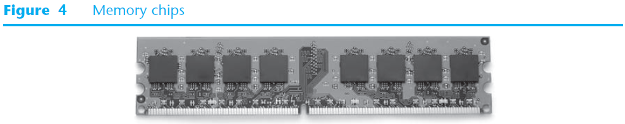
Inside your computer, RAM is stored in chips, similar to the ones shown in Figure 4.
Hardware: Main Memory

Slide 19
Secondary storage is a type of memory that can hold data for long periods of time, even when there is no power to the computer.
Programs are normally stored in secondary memory and loaded into main memory as needed.
Important data, such as
word processing documents
payroll data
inventory records
is saved to secondary storage as well.
Hardware: Secondary Storage

Slide 20
The most common type of secondary storage device is the disk drive.
A traditional disk drive stores data by magnetically encoding it onto a spinning circular disk.
Solid-state drives, which store data in solid-state memory, are increasingly becoming popular.
A solid-state drive has no moving parts and operates faster than a traditional disk drive.
External storage devices, which connect to one of the computer’s communication ports, are also available.
Hardware: Secondary Storage

Slide 21
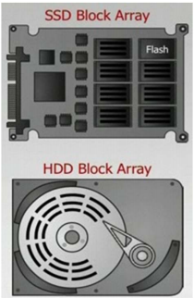
HDD vs. SSD
Same form factors – 1.8’’, 2.5’’, and 3.5’’
Interface –
SATA [Serial ATA (Advanced Technology Attachment)];
PCIe [PCI (Peripheral Component Interconnect) Express];
SCSI [Small Computer Systems Interface];
Users of the computer doesn’t necessarily know which is connected
Hardware: Secondary Storage

Slide 22
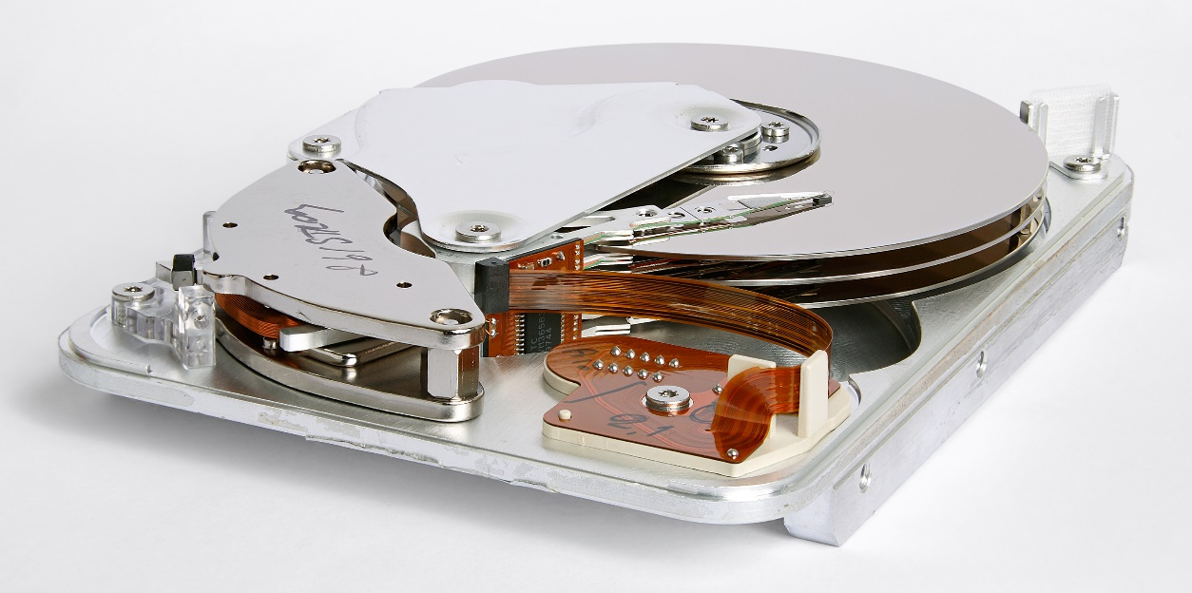
HDD
Always contain
more than one platter
There is a head for
each platter, but the
heads cannot move
independently
Cylinder – All tracks accessible without moving the head assembly
Head – The device that writes data to and reads the surface of one side of a platter
Hardware: Secondary Storage

Slide 23
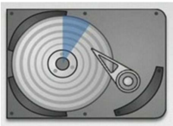
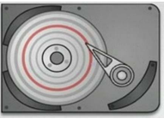
HDD Data Structure
Sector – A slice of the platter that contains the minimum addressable read/write portion – typically 512 bytes
Track – Thin concentric circular strips that contain portions of multiple sectors.
Head can access all data on a track without moving.
Hardware: Secondary Storage

Slide 24
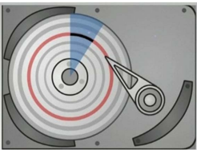
HDD Data Structure
Blocks – The intersection of a track and a sector
Minimum addressable size in the HDD.
Addresses are specified by providing the
cylinder
head
sector number
Hardware: Secondary Storage

Slide 25
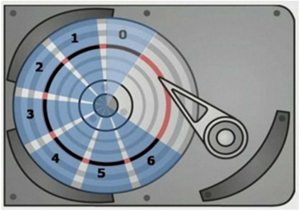
Logical Block Addressing (LBA)
A way of addressing blocks that simply numbers them linearly rather than providing a cylinder, head, and sector number
This scheme is generally replacing the Legacy Block Addressing scheme although both are supported on current SSDs and HDDs.
Hardware: Secondary Storage

Slide 26
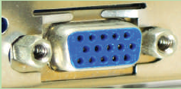
A VGA (Video Graphics Array) port, also called a
DB-15 port
HD15 port
DE15 port
is a 15-pin, D-shaped, female port that transmits analog video.
(Analog means a continuous signal with infinite variations as compared with Digital, which is a series of binary values—1s and 0s.)
Hardware: External Interfaces

Slide 27
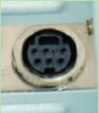
An S-Video port is a 4-pin or 7-pin round video port sometimes used to connect to a television.
The 7-pin port is shown in the picture above.
The 4-pin port is missing the extra pins in the middle and is the more common type.
Hardware: External Interfaces

Slide 28
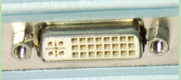
A DVI (Digital Video Interface) port transmits digital or analog video.
Hardware: External Interfaces

Slide 29
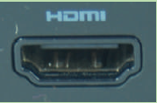
An HDMI (High-Definition Multimedia Interface) port transmits digital video and audio (not analog transmissions) and is often used to connect to home theater equipment.
Hardware: External Interfaces

Slide 30
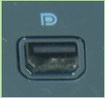
A DisplayPort transmits digital video and audio (not analog transmissions) and is slowly replacing VGA and DVI ports on personal computers.
Hardware: External Interfaces

Slide 31
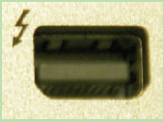
A Thunderbolt port transmits
video
data
power
on the same port and cable and is popular with Apple computers.
The port is shaped the same as the DisplayPort and is compatible with DisplayPort devices.
Up to 6 peripherals (for example, monitors and external hard drives daisy-chained together) can use the same Thunderbolt port.
Hardware: External Interfaces

Slide 32
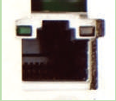
A network port, also called an Ethernet port, or an RJ-45 port, is used by a network cable to connect to the wired network.
Fast Ethernet ports run at 100 Mbps (megabits per second)
Gigabit Ethernet runs at 1000 Mbps or 1 Gbps (gigabits per second).
Hardware: External Interfaces

Slide 33
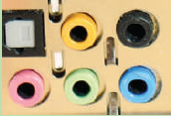
A system usually has three or more round audio ports, also called sound ports, for
a microphone
audio in
audio out
stereo audio out
These types of audio ports can transmit analog or digital data.
Hardware: External Interfaces

Slide 34
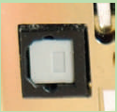
An S/PDIF (Sony/Philips Digital Interface) sound port connects to an external home theater audio system, providing digital audio output and the best signal quality.
S/PDIF ports always carry digital audio and can work with electrical or optical cable.
When connected to a fiber-optic cable, the port is called an optical connector.
Hardware: External Interfaces

Slide 35
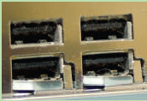
A USB (Universal Serial Bus) port is a multipurpose I/O port that comes in several sizes and is used by many different devices, including
printers
mice
keyboards
scanners
external hard drives
flash drives
Hardware: External Interfaces

Slide 36
Some USB ports are faster than others:
Hi-Speed USB 2.0 is faster than regular USB
Super-Speed USB 3.0 is faster than USB 2.0
Hardware: External Interfaces

Slide 37
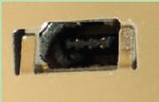
A FireWire port (also called an IEEE 1394 port, pronounced “I-triple-E 1394 port”) is used for high-speed multimedia devices such as digital camcorders.
Hardware: External Interfaces

Slide 38
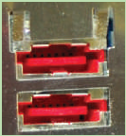
An external SATA (eSATA) port is used by an external hard drive or other device using the eSATA interface.
eSATA is faster than FireWire.
Hardware: External Interfaces

Slide 39
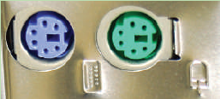
A PS/2 port, also called a mini-DIN port, is a round 6-pin port used by a keyboard or mouse.
The ports look alike but are not interchangeable.
On a desktop,
the purple port is for the keyboard
the green port is for the mouse
Many newer computers use USB ports for the keyboard and mouse rather than the older PS/2 ports.
Hardware: External Interfaces

Slide 40
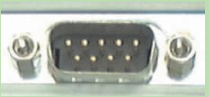
An older serial port, sometimes called a DB9 port, is a 9-pin male port used on older computers.
It has been mostly replaced by USB ports.
You may see a serial port on a router where the port is used to connect the router to a device a technician can use to monitor and manage the router.
Hardware: External Interfaces

Slide 41

A parallel port, also called an LPT port, is a 25-pin female port used by older printers.
This older port has been replaced by USB ports.
Hardware: External Interfaces

Slide 42
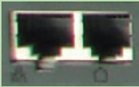
A modem port, also called an RJ-11 port, is used to connect dialup phone lines to computers.
A modem port looks like a network port, but is not as wide.
In the picture, the right port is a modem port and the left port is a network port, shown for comparison.
Hardware: External Interfaces

Slide 43
Many types of external storage devices have been created for copying data and for moving it to other computers.
Many types of external storage devices have been created for copying data and for moving it to other computers.
For many years floppy disk drives were popular.
A floppy disk drive records data onto a small floppy disk, which can be removed from the drive.
Hardware: Secondary Storage

Slide 44
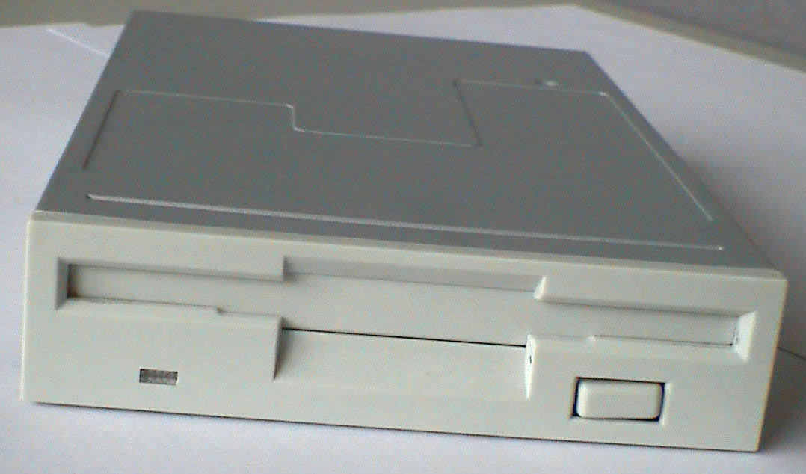
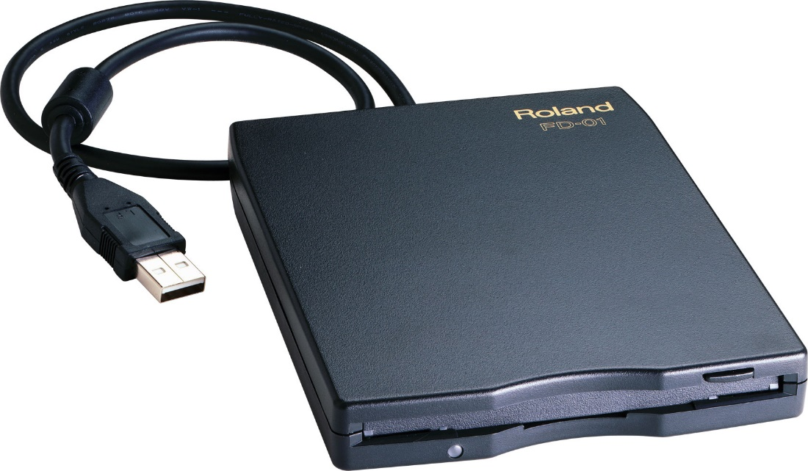
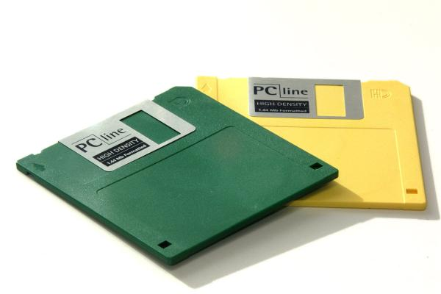

Slide 45
Floppy disks have many disadvantages, however:
they hold only a small amount of data
they are slow to access data
they can be unreliable
Floppy disk drives are rarely used today, in favor of superior devices such as USB drives.
USB drives are small devices that plug into the computer’s USB (universal serial bus) port and appear to the system as a disk drive.
These drives do not actually contain a disk, however.
They store data in a special type of memory known as flash memory.
Hardware: Secondary Storage

Slide 46
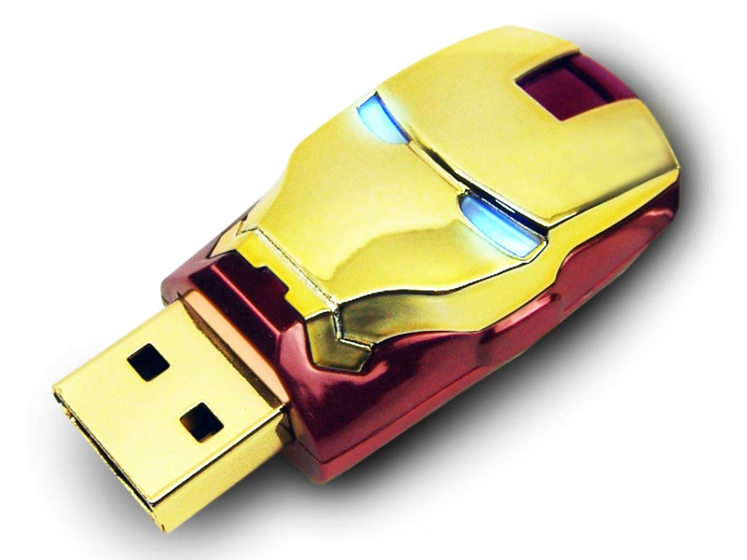
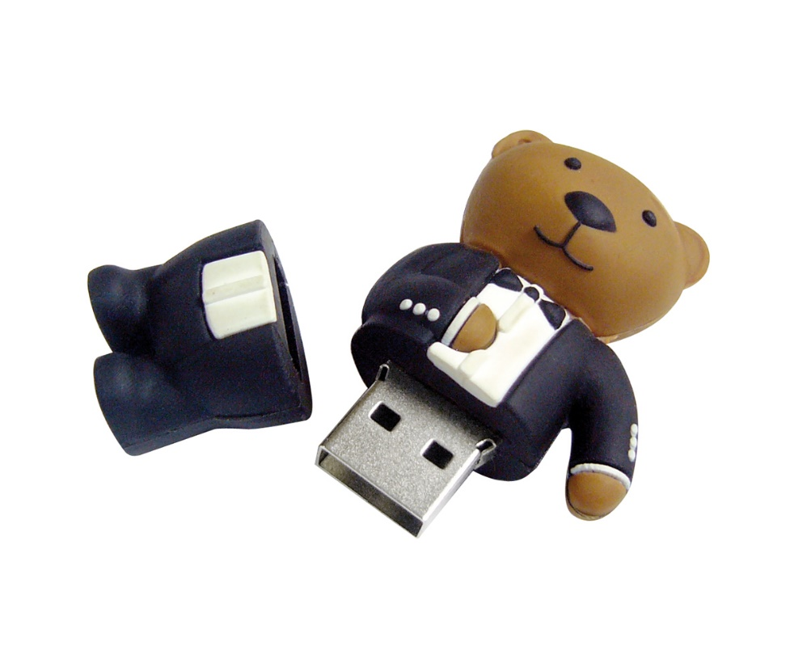
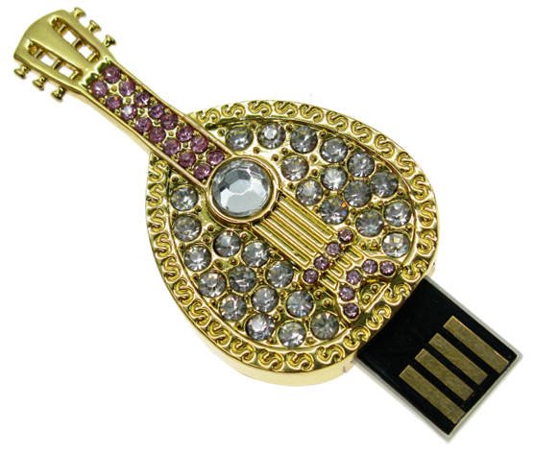

Slide 47
USB drives, which are also known as memory sticks and flash drives, are inexpensive, reliable, and small enough to be carried in your pocket.
Optical devices such as the CD (Compact Disc) and the DVD (Digital Versatile Disc) are also popular for data storage.
Data is not recorded magnetically on an optical disc, but is encoded as a series of pits on the disc surface.
CD and DVD drives use a laser to detect the pits and thus read the encoded data.
Hardware: Secondary Storage

Slide 48
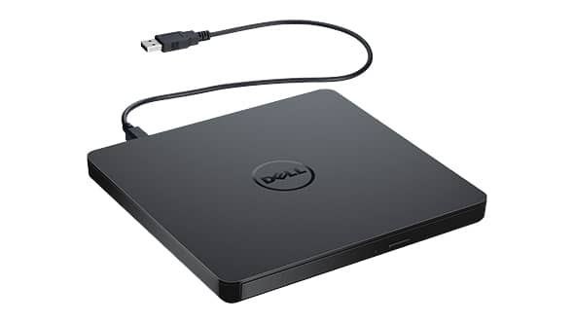
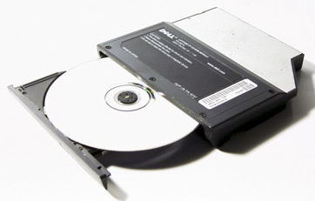
Optical discs hold large amounts of data, and because recordable CD and DVD drives are now commonplace, they are good mediums for creating backup copies of data.
Hardware: Secondary Storage

Slide 49
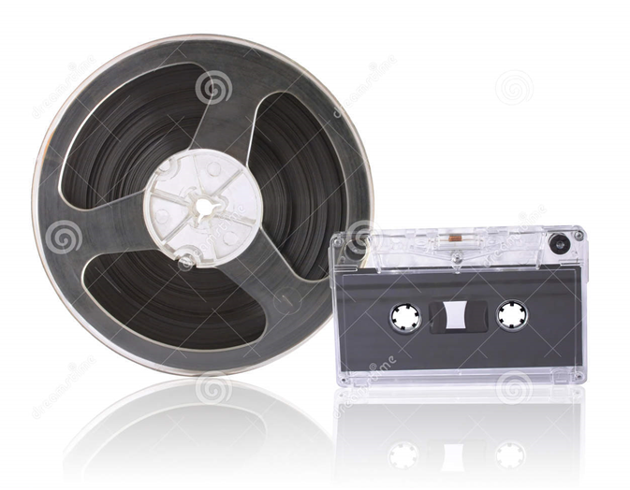
Magnetic Tapes
Hardware: Secondary Storage

Slide 50
A Redundant Array of Independent Disks (RAID) system is a collection of disk drives used for fault tolerance and improved performance, and is typically found in large network systems.
Data can be stored in multiple places to improve the system’s reliability.
In other words, if one disk in the array fails, data is not lost.
In some RAID configurations, sequences of data can be read from multiple disks simultaneously, which improves performance.
Hardware: Secondary Storage

Slide 51
Cloud storage has become a popular option for many organizations and individuals in recent years.
Used for online storage and backup, it involves multiple virtual servers that are usually hosted by third parties.
Examples include
Just Cloud
Zip Cloud
My PC Backup
iCloud
Dropbox, etc.
Hardware: Secondary Storage

Slide 52
Large corporations and enterprises that need a lot of storage space use a server farm or server cluster.
This is a collection of hundreds or thousands of computers that require a large amount of power to run and keep cool.
Hardware: Secondary Storage

Slide 53
Another component that affects computer performance is a bus, which is the link between devices connected to the computer.
A bus can be parallel or serial, internal (local) or external.
An internal bus enables communication between internal components, such as a video card and memory.
An external bus is capable of communicating with external components, such as a USB device.
Hardware: Bus

Slide 54
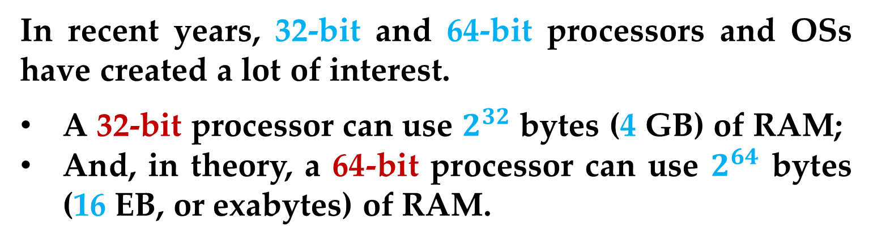
Other factors that affect computer performance include the processor size and the Operating System (OS).
In recent years, 32-bit and 64-bit processors and OSs have created a lot of interest.
A 32-bit processor can use $2^{32}$ bytes (4 GB) of RAM;
And, in theory, a 64-bit processor can use $2^{64}$ bytes (16 EB, or exabytes) of RAM.
So a computer with a 64-bit processor can perform calculations with larger numbers and be more efficient with smaller numbers; it also has better overall performance than a 32-bit system.
Hardware: Bus

Slide 55
A motherboard is the main circuit board containing connectors for attaching additional boards.
In addition, it usually contains
the CPU
Basic Input/Output System (BIOS)
memory
storage
interfaces
serial and parallel ports
expansion slots
all the controllers for standard peripheral devices (e.g. the display monitor, disk drive, and keyboard).
Hardware: Motherboard

Slide 56
A serial port is a communication interface through which information is transferred one bit at a time
A parallel port is usually an interface between a computer and a printer that enables the computer to transfer multiple bits of information to the printer simultaneously.
Hardware: Motherboard

Slide 57
Input is any data the computer collects from people and from other devices.
The component that collects the data and transfers it to the computer is called an input device.
Common input devices are
Keyboard and Mouse
Scanner
Microphone
Digital camera
Trackball
Barcode reader
Optical Character Reader (OCR)
Light pen
Hardware: Input Devices

Slide 58
Output is any data the computer produces for people or for other devices.
The data is sent to an output device, which formats and presents it in two different formats: “soft copy” and “hard copy”.
Common output devices are
Video displays (LCD, CRT, Plasma)
Printers (LaserJet, Inkjet, Dot Matrix)
Plotters
Speakers
etc.
Hardware: Output Devices

Slide 59
Some hardware can be categorized as both input and output devices.
Example
Disk drives and optical drives can be considered input devices because programs and data are retrieved from them and loaded into the computer’s memory.
Disk drives and optical drives can also be considered output devices because the system sends data to them in order to be saved.
Hardware: Input/Output Devices

Slide 60
Everything that a computer does, from the time you turn the power switch on until you shut the system down, is under the control of software.
There are two general categories of software:
System software
Application software
System software typically includes the following types of programs:
Operating systems
Utility programs
Software development tools
Software

Slide 61
Operating System Software
An Operating System (OS) is a set of programs for controlling and managing computer hardware and software.
It provides an interface between a computer and the user.
A typical OS consists of control programs and supervisor programs.
System Software

Slide 62
Control programs manage computer hardware and resources by performing the following functions:
Job management — Control and prioritize tasks performed by the CPU.
Resource allocation — Manage computer resources, such as storage and memory.
In a network, control programs, for example, are used for tasks, such as assigning a print job to a particular printer.
Communication — Control the transfer of data among parts of a computer system, such as communication between the CPU and I/O devices.
System Software

Slide 63
Data management — Control data integrity by generating checksums to verify that data has not been corrupted or changed.
When the OS writes data to storage, it generates a value (the checksum) along with the data.
The next time this data is retrieved, the checksum is recalculated and compared with the original checksum.
If they match, the integrity is intact.
If they do not, the data has been corrupted somehow.
System Software

Slide 64
The supervisor program, also known as the kernel, is responsible for controlling all other programs in the OS, such as
Compilers
Interpreters
Assemblers
Utilities
for performing special tasks.
System Software

Slide 65
Two new operating systems for smartphones and other handheld devices have attracted much attention in recent years: iOS and Android.
System Software

Slide 66
Utility Programs
A utility program performs a specialized task that enhances the computer’s operation or safeguards data.
Examples of utility programs are
virus scanners
file compression programs
data backup programs
etc.
System Software

Slide 67
Software Development Tools
Software development tools are the programs that programmers use to create, modify, and test software.
Examples of programs that fall into this category are:
assemblers
compilers
interpreters
etc.
System Software

Slide 68
A personal computer can perform a variety of tasks by using application software.
These are the programs that people normally spend most of their time running on their computers.
Application software can be commercial software or software developed in house.
In-house software is usually more expensive than commercial software but is more customized and often fits the users’ needs better.
Application Software

Slide 69
The following sections give you an overview of common categories of commercial application software for personal computers.
Word-Processing Software
You are probably most familiar with word-processing software used to generate documents.
Some popular word-processing programs are
Microsoft Word
Corel WordPerfect
iWork
OpenOffice
Application Software

Slide 70
Spreadsheet Software
A spreadsheet is a table of rows and columns, and spreadsheet software is capable of performing numerous tasks with the information in a spreadsheet.
Common spreadsheet software includes
Microsoft Excel
IBM’s Lotus 1-2-3
Corel Quattro Pro
Application Software

Slide 71
Database Software
Database software is designed to perform operations such as creating, deleting, modifying, searching, sorting, and joining data.
Popular database software for personal computers includes
Microsoft Access
FileMaker Pro
Alpha Software’s Alpha Five
High-end database software used in large enterprises includes
Oracle, IBM DB2, and Microsoft SQL Server.
Application Software

Slide 72
Presentation Software
Presentation software is used to create and deliver slide shows.
Microsoft PowerPoint is the most commonly used presentation software.
Other examples include Adobe Persuasion and Corel Presentations.
Application Software

Slide 73
Graphics Software
Graphics software is designed to present data in a graphical format, such as line graphs and pie charts.
Graphics can be created with integrated packages, such as
Excel
Lotus 1-2-3
Quattro Pro
or dedicated graphics packages, such as
Adobe Illustrator
IBM Freelance
Application Software

Slide 74
Desktop Publishing Software
Desktop publishing software is used to produce professional-quality documents without expensive hardware and software.
This software works on a “what-you-see-is-what-you-get” (WYSIWYG, pronounced “wizzy-wig”) concept, so the high-quality screen display gives you a good idea of what you will see in the printed output.
Many desktop publishing packages are available; three popular ones are
Adobe InDesign
QuarkXPress
Microsoft Office Publisher
Application Software

Slide 75
Project Management Software
A project, such as designing a Web site or setting up an order entry system, consists of a set of related tasks.
The goal of project management software is to help project managers keep time and budget under control by solving
scheduling problems
planning and setting goals
highlighting potential bottlenecks
There are several project management software packages on the market, including Microsoft Project and Micro Planning International’s Micro Planner.
Application Software

Slide 76
Computer-Aided Design Software
Computer-aided design (CAD) software is used for drafting and design and has replaced traditional tools, such paper and pencils.
It is used extensively in architecture and engineering firms.
Widely used CAD software includes
Autodesk Auto CAD
Cadkey
Versa CAD.
Application Software

Slide 77
Financial Planning and Accounting Software
Financial planning software, which is more powerful than spreadsheet software, is capable of performing many types of analysis on large amounts of data.
Some popular accounting software packages include
Intuit QuickBooks (a small-business accounting software)
Sage Software’s Peachtree
In addition to these, many other categories of software are available, such as information management software, Web-developing software, and photo and graphics software, etc.
Application Software

Slide 78
Microsoft, founded in 1975, is the world’s largest software company and is involved in all aspects of desktop computing.
It is best known for the Disk Operating System (DOS), Windows operating systems, and office software suites such as Office.
Here are some of the products and services Microsoft offers:
Windows: The most popular operating system for PCs and PC-compatible computers
Windows XP, Vista, 7, 8, 8.1, 10: Four widely used operating systems for PCs.
Microsoft Corporation

Slide 79
Here are some of the products and services Microsoft offers:
Windows Server 2003, Server 2008, Server 2010, Server 2012: Four widely used server operating systems used in network environments
Office: The most widely used office suite; includes Word, Excel, Access, and PowerPoint
Office 365: An online service, similar to Google Apps, that lets users collaborate on documents, spreadsheets, and e-mail using a combination of subscription desktop software and Web apps; includes Word, Excel, Exchange, and PowerPoint
Microsoft Corporation

Slide 80
Here are some of the products and services Microsoft offers:
Internet Explorer: A popular Web browser
Expression Web (replacing FrontPage): An HTML editor and Web design program for developing Web pages and other HTML applications
MSN: An Internet portal combining Web services and free Web-based e-mail (Hotmail)
SharePoint Server: Groupware for facilitating information sharing and content management
SQL Server 2008, 2010, 2012, and 2014 : Widely used database management systems
Microsoft Corporation

Slide 81
Here are some of the products and services Microsoft offers:
Xbox : A video game system
Visual Studio: An integrated development environment (IDE) that can be used to program applications in a number of different languages (such as C++, Java, Visual Basic, and C#); used for console or GUI applications as well as Web applications
Windows Live ID: A single sign-on service for multiple Web sites
Skype: A software application that allows users to communicate using voice, videos, and data over the Internet
Microsoft Corporation

Slide 82
Thank You for Attention

